Slide 1
Greek Relative Clauses
Prof. Vanessa Gorman
University of Nebraska-Lincoln
vgorman1@unl.edu

Slide 2
A relative clause is a subordinate clause that is not introduced by a subordinating conjunction.
Instead it contains a relative pronoun, adjective, or adverb that modifies a word in another clause [whether expressed or elided].
Translated “who,” “whose,” “whom,” “which,” “that,” [“where,” “when”]

Slide 3
Terminology of Relative Clauses
Antecedent = the word modified by the relative clause
Definite Relative Clause = refers to a specific antecedent
Alkibiades, whose father died when he was young, grew up in Perikles’ house.
The vase that has a crack in it was damaged in transport.
Indefinite Relative Clause = no specific antecedent [“anyone” or “whoever”]
Whoever comes in late will be penalized.
The man who invades Attica will be defeated.
[i.e., any man who does so]

Slide 4
Terminology
Restrictive Relative Clause
Defines the antecedent. It is necessary to understand the sentence.
Is not enclosed in commas in English; neuters are translated “that.”
The vase that has a crack in it was damaged in transport.
The sailor who survived the battle gave an account of the loss.
Non-restrictive Relative Clause [Digressive]
Offers additional information. Can be omitted without changing the meaning of the sentence.
Is enclosed in commas; neuters are translated “which.”
Alkibiades, whose father died when he was young, grew up in Perikles’ house.
The vase, which has a crack in it, was used to collect ballots.

Slide 5
Relative Clauses
The relative pronoun/adjective matches its antecedent in gender and number
It derives its case from its use in the subordinate clause.
She gave the ring to her brother, who was older than she was.
She gave the ring to her brother, whose wife had died.
She gave the ring to her brother, to whom their father had entrusted his cattle.
She gave the ring to her brother, whom the city exiled.
Each relative pronoun here will be masculine singular to match “brother”
The case will vary according to the syntax of the clause

Slide 6
Case | Sing | Pl |  | Sing | Pl |  | Sing | Pl
Nom | ὁ | οἱ |  | ἡ | αἱ |  | τὸ | τὰ
Gen | τοῦ | τῶν |  | τῆς | τῶν |  | τοῦ | τῶν
Dat | τῷ | τοῖς |  | τῇ | ταῖς |  | τῷ | τοῖς
Acc | τὸν | τοὺς |  | τὴν | τὰς |  | τὸ | τὰ
Definite Article

Slide 7
Case | Sing | Pl |  | Sing | Pl |  | Sing | Pl
Nom | ὁ | οἱ |  | ἡ | αἱ |  | τὸ | τὰ
Gen | τοῦ | τῶν |  | τῆς | τῶν |  | τοῦ | τῶν
Dat | τῷ | τοῖς |  | τῇ | ταῖς |  | τῷ | τοῖς
Acc | τὸν | τοὺς |  | τὴν | τὰς |  | τὸ | τὰ
Definite Article omit tau; add rough breathing and accent

Slide 8
Definite Article omit tau; add rough breathing and accent = Definite Relative Pronoun (“who”; “which/that”)
Case | Sing | Pl |  | Sing | Pl |  | Sing | Pl
Nom | ὁ | οἱ |  | ἡ | αἱ |  | τὸ | τὰ
Gen | τοῦ | τῶν |  | τῆς | τῶν |  | τοῦ | τῶν
Dat | τῷ | τοῖς |  | τῇ | ταῖς |  | τῷ | τοῖς
Acc | τὸν | τοὺς |  | τὴν | τὰς |  | τὸ | τὰ
Case | Sing | Pl |  | Sing | Pl |  | Sing | Pl
Nom | ὅς | οἵ |  | ἥ | αἵ |  | ὅ | ἅ
Gen | οὕ | ὧν |  | ἧς | ὧν |  | οὕ | ὧν
Dat | ᾧ | οἷς |  | ᾗ | αἷς |  | ᾧ | οἷς
Acc | ὅν | οὕς |  | ἥν | ἃς |  | ὅ | ἅ
Add a sigma to the masc nom sg

Slide 9
**Making a tree**
The verb of the relative clause hangs on the antecedent.
If the antecedent is a noun, it hangs as an ATR.
If the antecedent is an ADV, it hangs as an ADV.

Slide 10
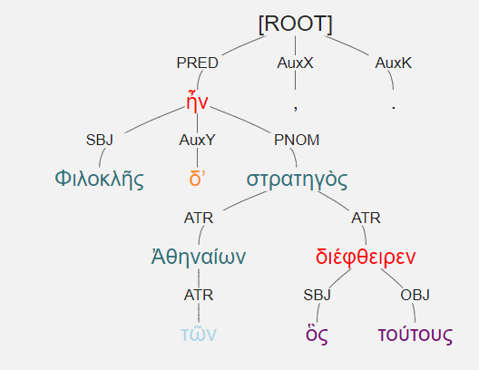
Φιλοκλῆς δʼ ἦν στρατηγὸς τῶν Ἀθηναίων, ὃς τούτους διέφθειρεν. [2.1.31]
Philokles was the Athenian general who killed them.
Antecedent = στρατηγός
Gender + number = masc sg
Nominative = SBJ of clause

Slide 11
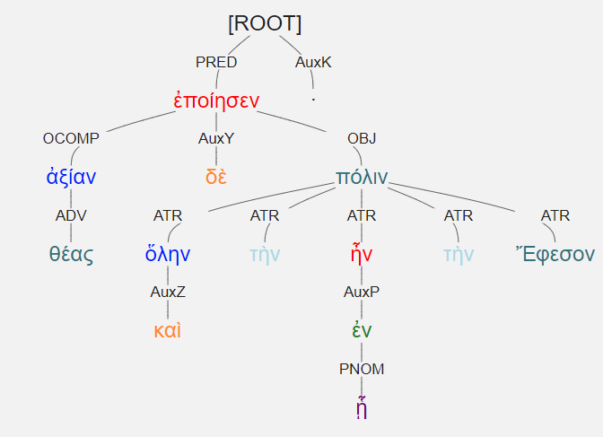
ἀξίαν δὲ καὶ ὅλην τὴν πόλιν ἐν ᾗ ἦν τὴν Ἔφεσον θέας ἐποίησεν. [3.4.17]
He made even the entire city, Ephesos, in which he was staying, worthy of the goddess.
Antecedent = πόλις = fem sg
Function in clause = obj of prep. = dat Acting as PNOM in clause

Slide 12
**Making a tree**
The verb of the relative clause hangs on the antecedent.
If the antecedent is a noun, it hangs as an ATR.
If the antecedent is an ADV, it hangs as an ADV.
If the antecedent is elided, then the verb of the clause stands in for the antecedent in the main clause and is labeled appropriately.

Slide 13
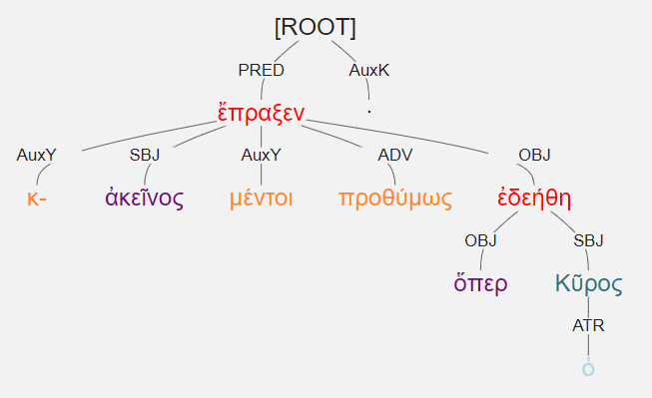
κἀκεῖνος μέντοι προθύμως ὅπερ ἐδεήθη ὁ Κῦρος ἔπραξεν. [3.1.1]
And of course that man did eagerly the very thing that Cyrus asked.
No expressed antecedent [τοῦτο or similar] = nt sg
The verb of the clause is labeled as the antecedent would have been
Accusative = OBJ in clause
μέντοι implies a strong protestation
-περ on the relative is an intensifier

Slide 14
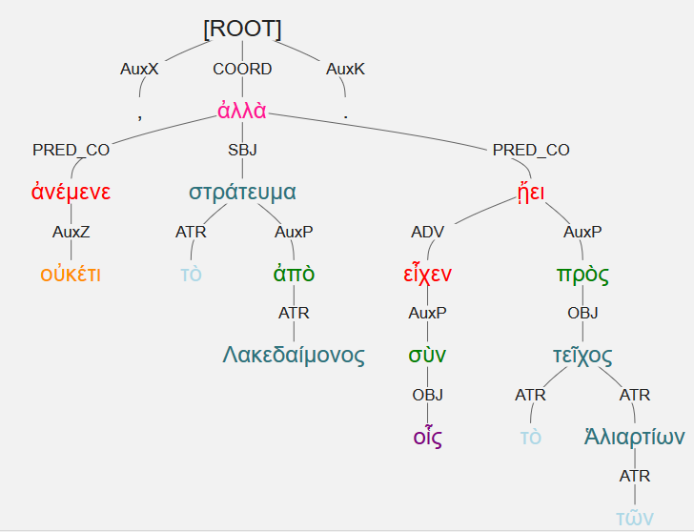
οὐκέτι ἀνέμενε τὸ ἀπὸ Λακεδαίμονος στράτευμα, ἀλλὰ σὺν οἷς εἶχεν ᾔει πρὸς τὸ τεῖχος τῶν Ἁλιαρτίων. [3.5.18]
The army from Lakedaimon no longer waited, but it came to the walls of Haliartios with those it had.
Relative Attraction
The relative pronoun is attracted to the case of its missing antecedent.
Only in restrictive clauses
Only when the relative pronoun should be accusative
Only when the antecedent should be genitive or dative [often with prep]
The labels are messed up accordingly.

Slide 15
Definite relative pronoun
Case | Sing | Pl |  | Sing | Pl |  | Sing | Pl
Nom | ὅς | οἵ |  | ἥ | αἵ |  | ὅ | ἅ
Gen | οὕ | ὧν |  | ἧς | ὧν |  | οὕ | ὧν
Dat | ᾧ | οἷς |  | ᾗ | αἷς |  | ᾧ | οἷς
Acc | ὅν | οὕς |  | ἥν | ἃς |  | ὅ | ἅ

Slide 16
Definite relative pronoun + indefinite pronoun/adjective
Case | Sing | Pl |  | Sing | Pl |  | Sing | Pl
Nom | ὅς | οἵ |  | ἥ | αἵ |  | ὅ | ἅ
Gen | οὕ | ὧν |  | ἧς | ὧν |  | οὕ | ὧν
Dat | ᾧ | οἷς |  | ᾗ | αἷς |  | ᾧ | οἷς
Acc | ὅν | οὕς |  | ἥν | ἃς |  | ὅ | ἅ
τις | τι
τινος/του | τινος/του
τινι/τῳ | τινι/τῳ
τινα | τι
τινες | τινα
τινων | τινων
τισι(ν) | τισι(ν)
τινας | τινα

Slide 17
ὅς + τις = ὅστις Indefinite Relative Pronouns [whoever; whatever]
Case | Sing | Pl |  | Sing | Pl |  | Sing | Pl
Nom | ὅστις | οἵτινες |  | ἥτις | αἵτινες |  | ὅτι | ἅτινα /ἅττα
Gen | οὗτινος /ὅτου | ὧντινων /ὅτων |  | ἧστινος /ὅτου | ὧντινων /ὅτων |  | οὗτινος /ὅτου | ὧν
Dat | ᾧτινι/ ὅτῳ | οἷστισι(ν) /ὅτοις |  | ᾗτινι/ ὅτῳ | aἷστισι(ν) /ὅτοις |  | ᾧτινι/ ὅτῳ | οἷς
Acc | ὅντινα | οὕστινας |  | ἥντινα | ἃστινας |  | ὅτι | ἅτινα /ἅττα

Slide 18
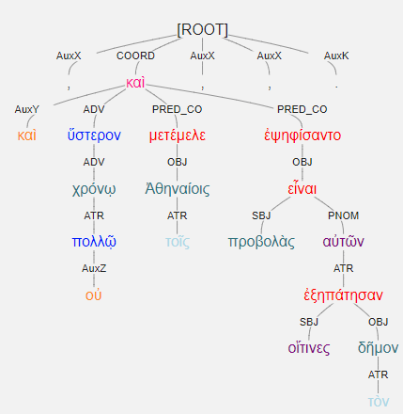
καὶ οὐ πολλῷ χρόνῳ ὕστερον μετέμελε τοῖς Ἀθηναίοις, καὶ ἐψηφίσαντο, οἵτινες τὸν δῆμον ἐξηπάτησαν, προβολὰς αὐτῶν εἶναι. [1.7.35]
And not much later, it bothered the Athenians, and they voted that bonds be posted by those men, whoever deceived the people.

Slide 19
Relative Adjectives and Adverbs
Relative Adjectives [definite > indefinite]
οἷος > ὁποῖος such as; of a kind that
ὅσος > ὁπόσος as great, as many; all who
Relative Adverbs
οὗ > ὅπου where; wherever
ὅθεν > ὁπόθεν whence; from wherever
οἷ > ὅποι whither; to wherever
ᾗ > ὅπῃ by which [dat]; by whatever
ὡς > ὅπως as, like; how

Slide 20
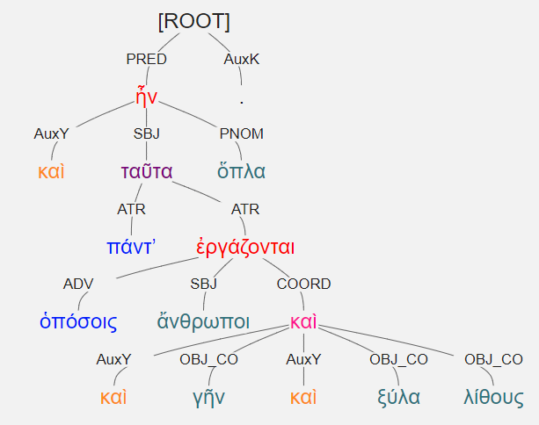
καὶ ταῦτα ὅπλα πάντʼ ἦν ὁπόσοις ἄνθρωποι καὶ γῆν καὶ ξύλα καὶ λίθους ἐργάζονται. [3.3.7]
All these things, as many as men use to work the earth and wood and stone, were weapons.

Slide 21
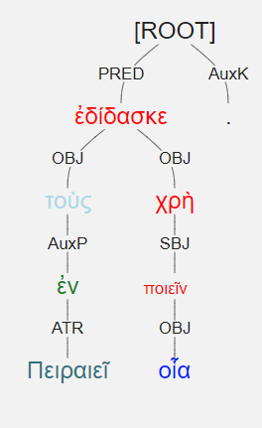
ἐδίδασκε τοὺς ἐν Πειραιεῖ οἷα χρὴ. [2.4.35]
He was teaching the men in the Peireios what sorts of things they needed [to do].

Slide 22
Correlatives
Some pronouns, adjectives, and adverbs correspond to each other
Often occur in pairs
That one … who ….
so many … how many …
There … where …
Then … when …
Thus … how …

Slide 23
Examples of Correlatives
Interrogative who? how many? when?
Indefinite someone of some quantity some time
Demonstrative this one so many then
Relative who as many as when
Indefinite Relative whoever however many whenever

Slide 24
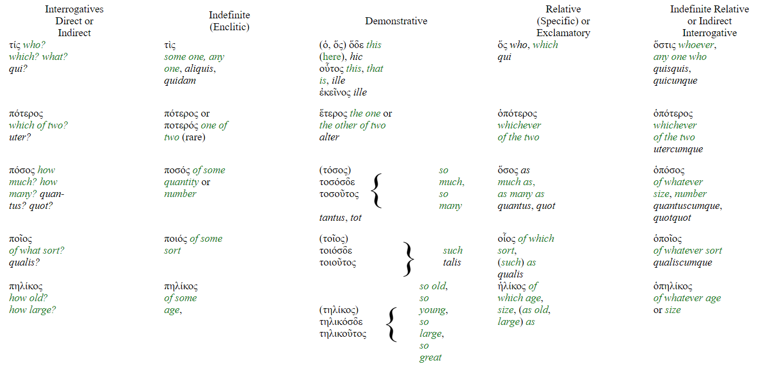
Correlative pronouns/adjectives Smyth 340

Slide 25
Interrogatives = questions
Semi-colon used as a question mark.
τίς, τί without an accent [enclitic] = indefinite pronoun
Someone, something
τίς, τί with an accent = direct or indirect interrogative pronoun
Who? What/Why?
τίς γὰρ ἤδη καταλείπεται αὐτοῖς εὐμενής; [3.5.11]
For who remains who is well-disposed to them?
οἱ δʼ Ἀθηναῖοι ἠπόρουν τί χρὴ ποιεῖν. [2.2.11]
The Athenians were at a loss as to what it was necessary to do.

Slide 26
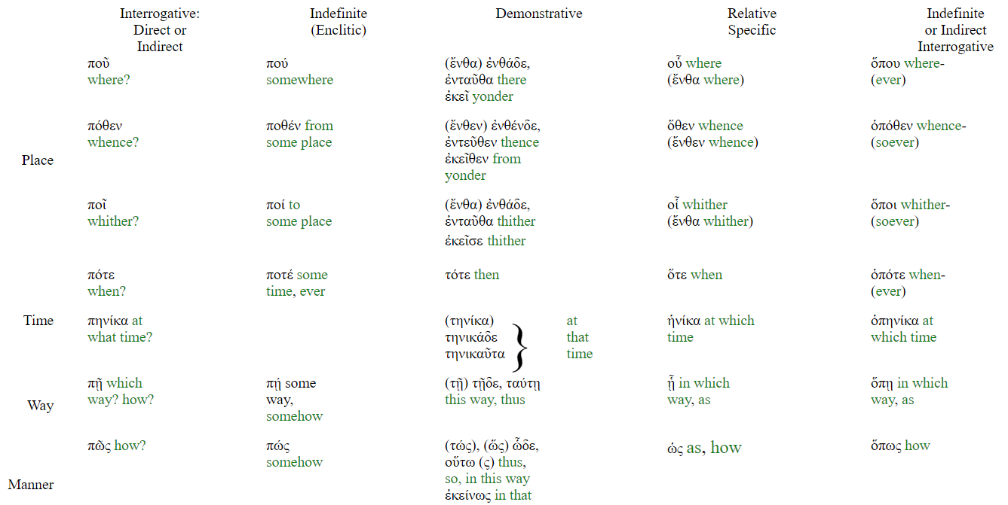
Correlative adverbs, Smyth 346

Slide 27
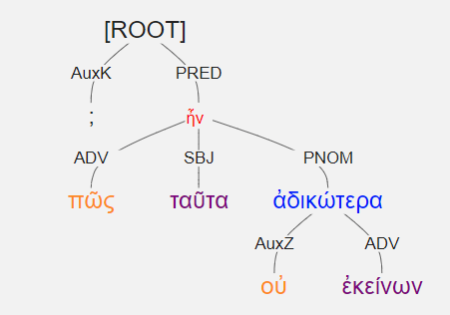
πῶς οὐ ταῦτα ἐκείνων ἀδικώτερα; [2.3.23]
How were these things not more unjust than those?

Slide 28
Summary of new vocabulary
Form | Meaning | Count | Rank | POS
ἅτε | just as if | 26 | 298 | adv
οἷος | of what sort | 43 | 187 | adj
ὁπόσος | of whatever number | 22 | 346 | adj
ὁπότε | whenever | 22 | 345 | adv
ὅπου | wherever | 21 | 374 | adv
ὅπως | however | 90 | 95 | adv
ὅς | who | 439 | 16 | adj
ὅσος | as many as | 115 | 70 | adj
ὅστις | whoever | 42 | 193 | adj
τοιοῦτος | such | 50 | 157 | adj
τοσοῦτος | so many | 24 | 328 | adj

